Slide 1
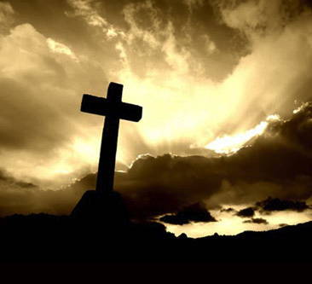
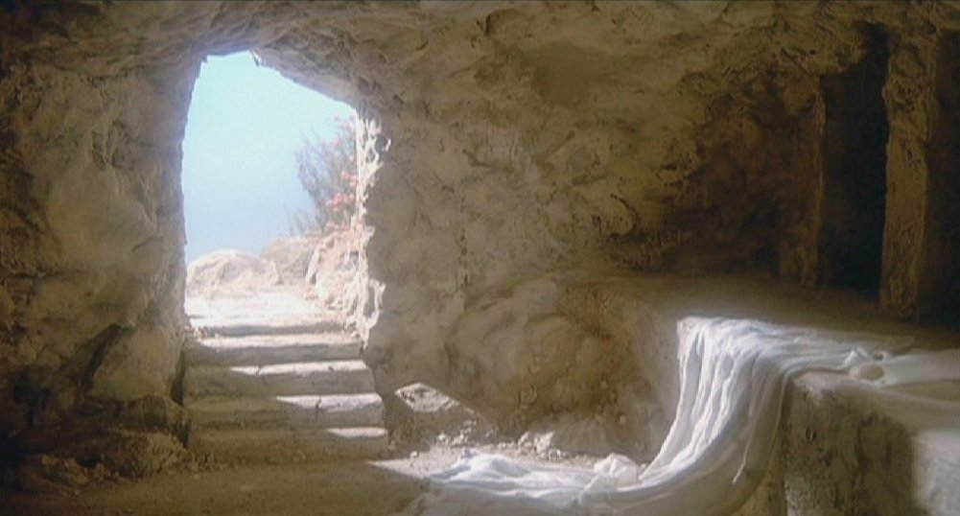
The Cross & the Resurrection

Slide 2
Now I want to remind you of the gospel I preached to you, which you received and on which you have taken your stand. By this gospel you are saved if you hold firmly to the word I preached to you. Otherwise you have believed in vain.
1 Cor. 15:1,2
The Cross & the Resurrection
& You

Slide 3
The Cross/Resurrection & Me in Galatians
A Substitution and a Rescue
Grace and peace to you from God our Father and the Lord Jesus Christ, who gave himself for our sins to rescue us from the present evil age…
1:3-4

Slide 4
The Cross/Resurrection & Me in Galatians
A Substitution and a Rescue
Grace and peace to you from God our Father and the Lord Jesus Christ, who gave himself for our sins to rescue us from the present evil age…
1:3-5

Slide 5
The Cross/Resurrection & Me in Galatians
A Substitution and a Rescue
Grace and peace to you from God our Father and the Lord Jesus Christ, who gave himself for our sins to rescue us from the present evil age…
1:3-5
Free from the law’s demand and
free from being ruled by human emotions

Slide 6
The Cross/Resurrection & Me in Galatians
My experience/connection with the Cross/resurrection
For through the law I died to the law so that I might live for God. I have been crucified with Christ and I no longer live, but Christ lives in me. The life I live in the body, I live by faith in the Son of God, who loved me and gave himself for me.
2:19-21

Slide 7
The Cross/Resurrection & Me in Galatians
My experience/connection with the Cross/resurrection
For through the law I died to the law so that I might live for God (resurrected life). I have been crucified with Christ and I no longer live, but Christ lives in me.

Slide 8
The Cross/Resurrection & Me in Galatians
My experience/connection with the Cross/resurrection
The life I live (resurrected life) in the body, I live…
through faith from the Son of God, (Berean Literal);
by the faith of the Son of God (Aramaic Bible);
in the faith of the Son of God (Douay-Rheims & Literal Standard);
by the faithfulness of the Son of God (International Standard)
because of the faithfulness of the Son of God (NET)

Slide 9
Romans 6:1-5
What shall we say, then? Shall we go on sinning so that grace may increase? By no means! We died to sin; how can we live in it any longer? Or don’t you know that all of us who were baptized into Christ Jesus were baptized into his death? We were therefore buried with him through baptism into death in order that, just as Christ was raised from the dead through the glory of the Father, we too may live a new life. For if we have been united with him like this in his death, we will certainly be united with him in his resurrection.

Slide 10
How Do I Live This Resurrected Life?
Not by my own efforts and work
How is it that you are turning back to those weak and miserable principles? Do you wish to be enslaved by them all over again? (Gal. 4:9)

Slide 11
How Do I Live This Resurrected Life?
Learning to live in Christ
Now the Lord is the Spirit, and where the Spirit of the Lord is, there is freedom. And we, who with unveiled faced all reflect (or contemplate) the Lord’s glory, are being transformed into his likeness with ever increasing glory, which comes from the Lord, who is the Spirit. (2 Cor. 4:17,18)

Slide 12
Living in law or living in Christ?
Teacher, what is the greatest commandment in the law? Jesus replied, Love the Lord you God with all your heart and with all your soul and with all your mind (Matt. 22:36,37)
All – the entire, whole, complete

Slide 13
Living in law or living in Christ?
In the same way, any of you who does not give up everything he has cannot be my disciple
(Luke 14::33)

