Slide 1
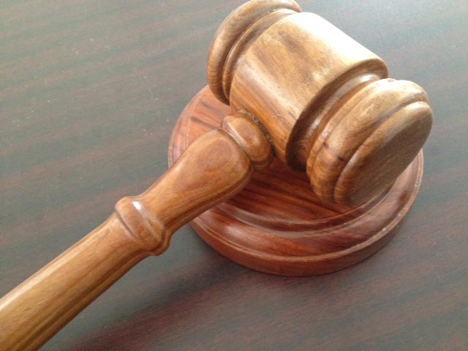
The Courtroom of Heaven
What’s the charges?
Two “who” questions
Romans 8:33,34

Slide 2
Who will bring any charge against those whom
God has chosen? It is God who justifies.
Who is he that condemns? Christ Jesus, who died – more than that, who was raised to life – is at the right hand of God and is also interceding for us.
Romans 8:33, 34

Slide 3
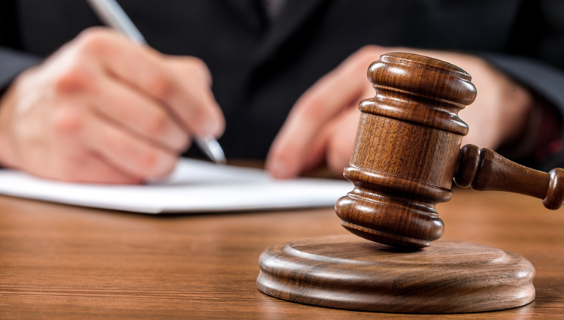
The Law
“those who obey the law who will be declared righteous” Romans 2:13
Satan
The Judicial Charge
Who brings the charges?
Who Sets the Sentence?
The World
Ourselves
Family & Friends
Two “Who” Questions

Slide 4
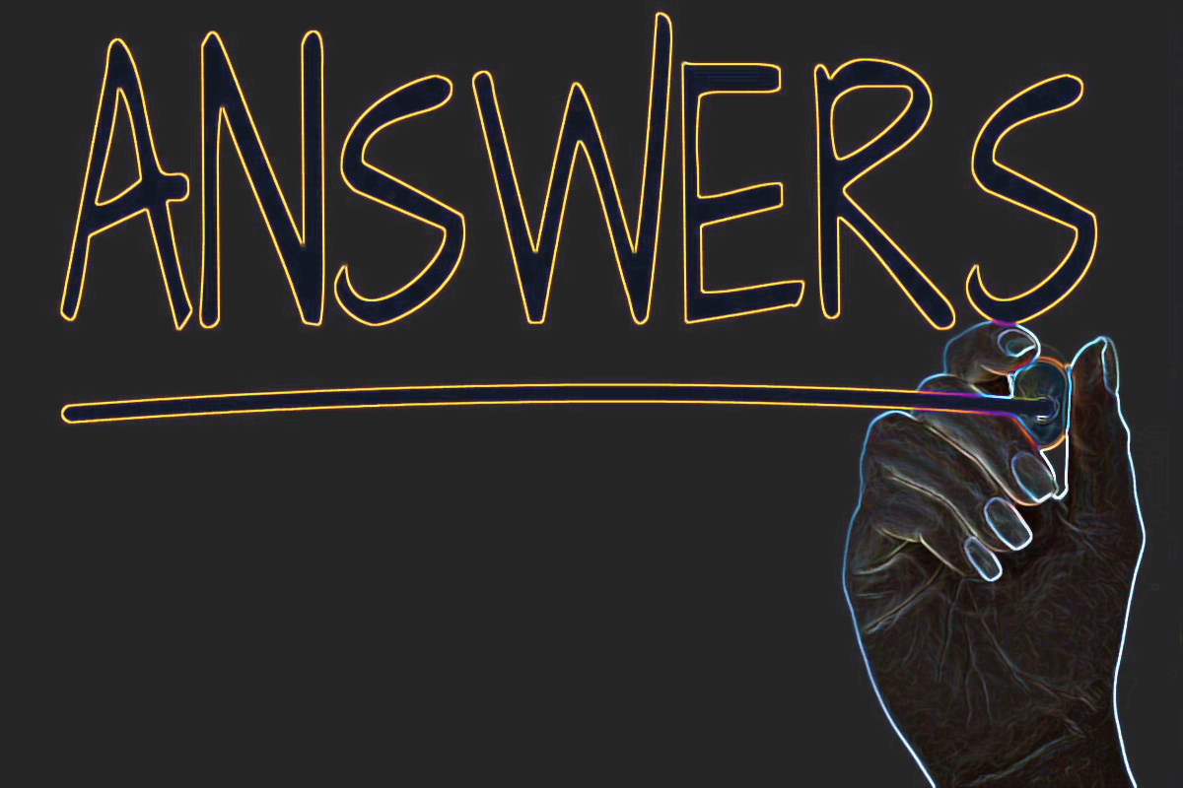
God
“Not guilty”
Christ
God is the Supreme Court of Eternal Justice
Jesus in a place of authority:
Right hand of God; interceding
His Work

Slide 5
“The choice ones.”
He who vindicates me is near.
Who then will bring charges against me? Let us face each other! Who is my accuser? Let him confront me!
It is the Sovereign Lord who helps me.
Who is he that will condemn me?
They will all wear out like a garment;
the moths will eat them up.
Isaiah 50:8,9

Slide 6
God is on my side
God made me just-as-if-I-had-never-sinned
Christ represents me – prays for me

Slide 7
Who will swear out a deposition with charges
against the choice ones of God? God Himself continually renders the verdict “right-with-God.”
Who are the ones crying out for a guilty verdict?
Christ Jesus died and even more, was raised out of death! Now he is in partnership with God
ruling the universe. He represents us, speaking
and praying on our behalf.

