Slide 1
Four “Who” Questions with the same Answer
First “Who”
Romans 8:31, 32

Slide 2
What, then, shall we say in response to this?
If God is for us, who can be against us?
He who did not spare his own Son, but gave him
up for us all – how will he not also, along with him, graciously give us all things?
Romans 8:31,32

Slide 3
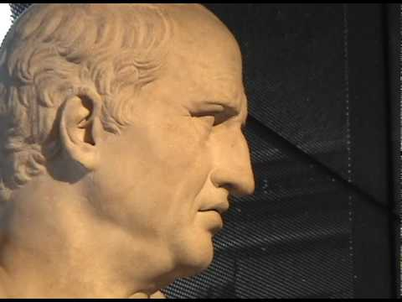
“Poor Cicero never had a subject like this nor a
mind so filled with
spiritual light.”
“What has Cicero ever said more grandiloquently?”
What shall we say?
“these things”
In view of all
the things
previously stated

Slide 4
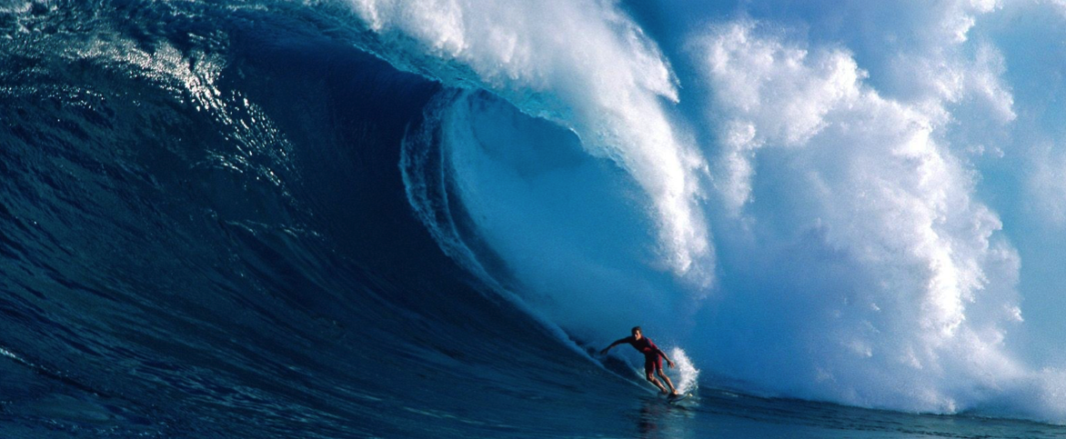
If GOD is for us
who cares who’s against us?
He who did not spare his own Son, but gave him up for us all – how will he not also, along with him, graciously give us all things?
Who is against us?

Slide 5
He could have spared him and not spared you. But he did not spare his Son so that he could spare you.
He who did not spare his own Son
“God…who really did not spare his own Son.”

Slide 6
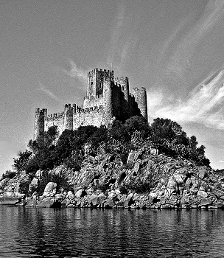
The Lord is my light and my salvation – whom shall I fear?
The Lord is the stronghold of my life – of whom shall I be afraid?
When evil men advance against me….when my enemies and foes attack me…though an army besiege me…though war break out against me…
My heart will not fear…even then will I be confident….

Slide 7
The Lord is my light and my salvation – whom shall I fear?
The Lord is the stronghold of my life – of whom shall I be afraid?
When communism advances against me….when a virus attacks me…though the government
besiege me with rules and restrictions…though I cannot breathe without offending someone…

Slide 8
To you, O my heart, he has said,
‘Seek my face!’
Your face, Lord,
I will seek.

Slide 9
In view of all these things, what is left to be said? Since God’s focus is for our interest and our betterment, does it matter a whit who opposes us?
Grasp this! God’s own, specially loved and divine Son, he did not cling to, but turned him over. He gave him up for each and every one of us. How could One with such sacrificial generosity, not graciously give us, along with him, the totality of what we now need?

Slide 10
Where your focus lies – so lies your fear.
In the fear of the LORD one has strong confidence,
and his children will have a refuge. ~ Proverbs 14:27
And He will be the stability of your times,
A wealth of salvation, wisdom and knowledge;
The fear of the LORD is his treasure.
Isaiah 33:6

