Slide 1
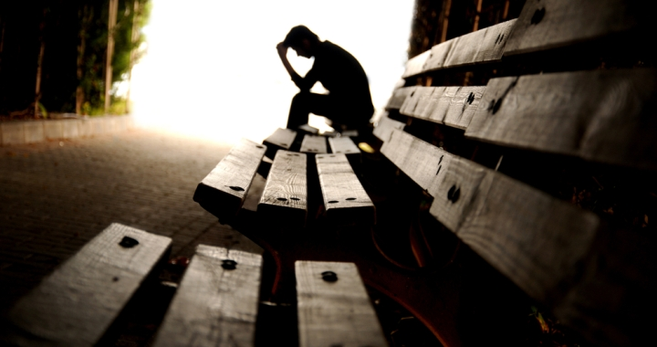
Suffer Together; Glory Together
Romans 8:17

Slide 2
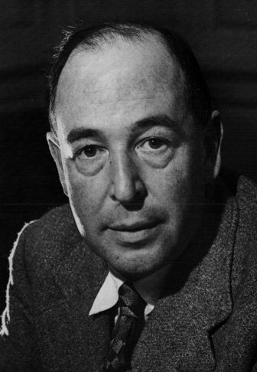
‘If God were good, He would wish to make His creatures perfectly happy, and if God were almighty, He would be able to do what He wished. But the creatures are not happy. Therefore, God either lacks goodness, or power, or both.”

Slide 3
…co-heirs with Christ, if indeed we share in his sufferings in order that we may also share in his glory
Romans 8:17b

Slide 4
Co-sufferers
1 Corinthians 12:26: If one part suffers, every part suffers with it…

Slide 5
The beginning of
our suffering
I have been crucified with Christ, and I
no longer live,
but Christ lives in me.
Gal 2:20
When Christ, who is your life…
Col. 3:4
We were therefore buried with him through baptism into death Romans 6:4
His life is my life

Slide 6
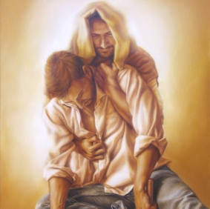
“Saul, Saul, why do you persecute me?” Acts 9:4
We suffer
with Christ,
“I tell you the truth, whatever you did for one of the least of these brothers of mine, you did for me.” Matthew 25:40
Christ suffers
with us

Slide 7
Praise be to the God and Father of our Lord Jesus Christ, the Father of compassion and the God of all comfort who comforts us in all our troubles, so that we can comfort those in any trouble with the comfort we ourselves have received from God. For just as the sufferings of Christ flow over into our lives, so also through Christ our comfort overflows. If we are distressed, it is for your comfort and salvation; if we are comforted, it is for your comfort, which produces in you patient endurance of the same suffering we suffer. And our hope for you is firm, because we know that just as you share in our sufferings, so also you share in our comfort.
2 Cor. 1:3-7

Slide 8
Phil 1:29 – For it has been granted (gifted; graced) to you on behalf of Christ not only to believe in him, but also to suffer for him,
Col. 1:24 - Now I rejoice in what I am suffering for you, and I fill up in my flesh what is still lacking in regard to Christ’s afflictions, for the sake of his body, which is the church.
1 John 3:16 - This is how we know what love is: Jesus Christ laid down his life for us. And we ought to lay down our lives for our brothers and sisters.

Slide 9
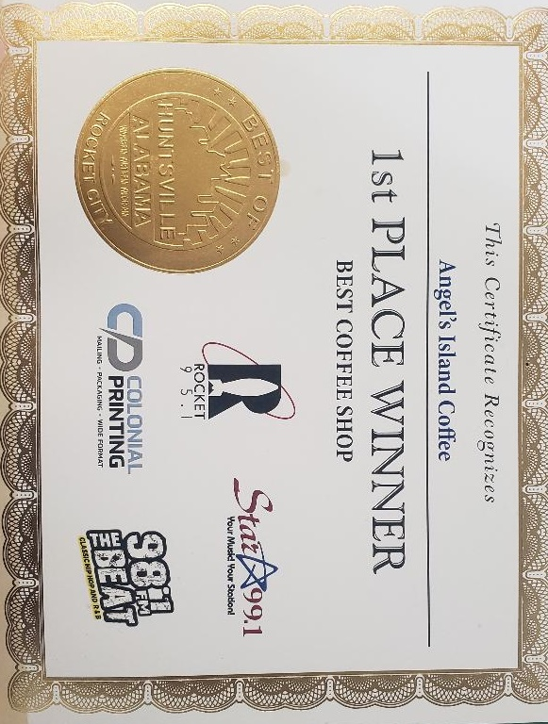
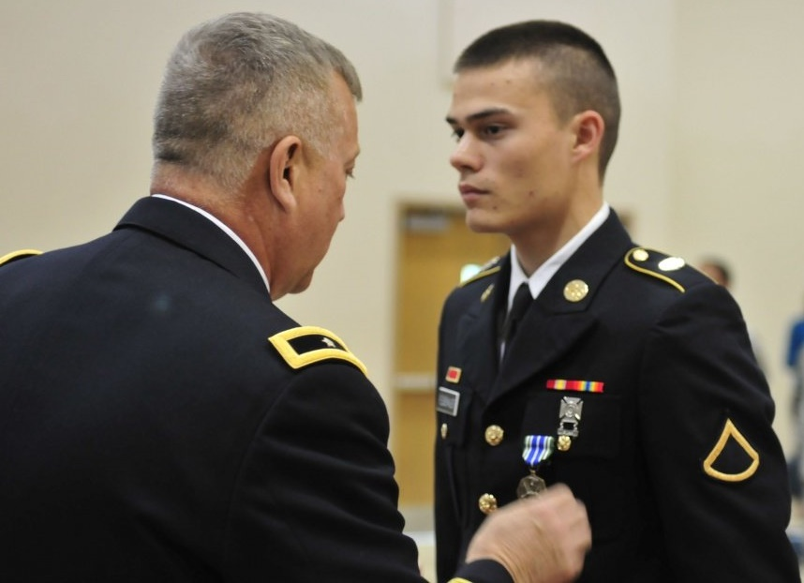
The purpose of suffering – Glory
In bringing many sons to glory, it was fitting that God, for whom and through who everything exists, should make the author of their salvation perfect through suffering ~ Heb 2:10
Glory
Because he himself suffered when he was tempted, he is able to help those who are being tempted
Heb. 2:18

Slide 10
I ask you, therefore, not to be discouraged because of my sufferings for you, which are your glory.
Eph 3:13
What are you feeding your emotions?
What story are you telling yourself?

Slide 11
Endure hardship as discipline; God is treating
you as sons…No discipline seems pleasant at
the time, but painful. Later on, however, it
produces a harvest of righteousness and
peace for those who have been trained by it.
Hebrews 12:7,11

