Slide 1
Payday or Birthday?
Romans 6:23

Slide 2
For the wages of sin is death, but the gift of God is eternal life in Christ Jesus our Lord
Romans 6:23

Slide 3
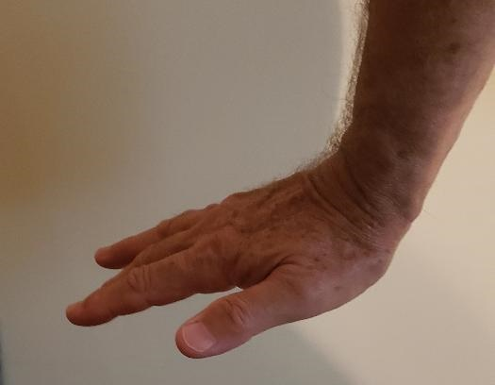
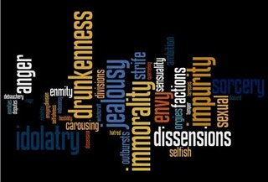
Under the dominion of Sin
The Wages of Sin
Daily death
Pride, lust, anger, envy, gluttony, greed, laziness.
The Works of the Flesh
Galatians 5:19-21

Slide 4
Not: “the wages of righteousness”
Wages
Sin/Law
Gift
Grace
Righteousness
Gift of God

Slide 5
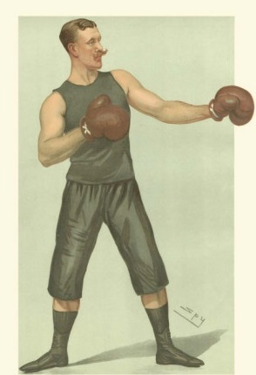
Eternal Life
“Free from sin” does not mean free from sinning.
Free to fight sin under your new Lord.

Slide 6
What shall I say to this? Should I live under
the same roof as Sin just so that there will be
a superabundance of Grace? Ridiculous!
I forever left the dominion of sin; how can I say
it’s still my home? It is quite clear that when I
was immersed into Christ Jesus I was plunged
into his death and bonded to every
benefit of his death.

Slide 7
Let me connect the dots for you:
Through a dipping under water,
I was buried with him into death.
This began a total separation from my old life.
Christ was raised, out from the dead,
by the magnificent majesty of the Father.
In exactly the same way, I am also
raised up like him, so that I might live
my new life in a uniquely new way.

Slide 8
In view of the fact that my baptism intertwined me
with him into a mirror image of his death,
I will certainly experience a similar likeness of his resurrection. Thus experiencing this: the “old me”
was crucified with him. The expressed purpose
of that crucifixion was so that the life of “Selfish Me”
might be completely defective thus I am no
longer slavishly devoted to “Sinful Me.”
For having experienced this death, God’s judgement pronounced me “just-as-if-I-had-never-sinned.”

Slide 9
On top of all of this, if I in fact died with Christ, I am firmly persuaded and am confident that I will also live with him.
For I have come to grasp that Christ, having been raised up from the dead will never face death again. He is outside of death’s jurisdiction and is no longer under its rule. The death Christ died was a one-time-death, but now, the life he currently lives, he lives oriented to God. So in the same way, I consider and think of “Selfish-Me” as truly a lifeless corpse in regard to “Sinful-me.” But indeed, now I live oriented with eyes toward God while implanted in Christ Jesus.

Slide 10
This is how it all comes together: I must not allow for any possibility for “Sinful-Me” to be King and pay attention
and comply to the urges, feelings and passionate
longings of my physical body. Neither will I keep on pampering any part of my personality using it as a
weapon or excuse toward hurtful living centered in
“Sinful Me”. Rather I will yield myself to God just as
if I was snatched out of death to Living! My whole
personality as a tool of right conduct oriented toward God

Slide 11
Because of this, it rules out as fact that sin
will ever dominate me. For I am in no way
under the rule of any kind of law.
I am subject to the power of God’s
kindness, love and blessing.
What then? Since I no longer abide under any kind of rule or regulation but under God’s favor, kindness and blessings, can’t I leave open the possibility of sin and indulge “Me” just a little? What a crazy notion!

Slide 12
It is so obviously clear that if I worshipfully listen
and wholly submit to anyone as a slave then I am compelled to obey him. It matters not whether I am a slave to any sort of sin (with the result of death) or whether a slave of obedience (with the result of correct living.)

Slide 13
But thank God! I used to be a slave to the Selfish and Sinful Me but now…!... with every fiber of my being and with full attention and compliance I am molded by the teaching into which God placed me.
I have been emancipated from “The Sin of Me”
and have been placed in bondage to right living.
I’m using a down-to-earth example because it’s
difficult to think in spiritual terms:

Slide 14
I used to be tied up in all sorts of impurity.
My thoughts muddied, feelings mixed, words filthy
and actions addicted; truly a type of slavery following the call of any and all of the world’s pollution.
I was in a downward spiral from chaos to anarchy,
living unruly and rebellious, a mutineer against anything God had to say.

Slide 15
But now, just as I was once wholeheartedly devoted to that kind of life, I have turned that slavery around
and have bonded the whole of myself to God’s
right way of living. Allowing Him to clear
my thinking, keep my feelings focused,
make my words fitting and actions guided under the rule and approval of God’s direction and justice.
This “slavery” leads me up a progressive
path of a continually transformed Life.

Slide 16
When I was enslaved to The Sin of Me, I turned my
nose up at anything termed “righteous” and was elated
to throw myself totally in the life of “Selfish Me.”
Being control by correct and right living
meant nothing to me
What fruit did I enjoy with that type of living?
No fruit at all! Just shame at the memory of it.
It was a dead-end life of death.

Slide 17
But now I am liberated!
Emancipated from Selfish and Sinful Me!
I’m now bound to God and willingly enslaved to him. The fruit I enjoy is a harvest of becoming more like him. The path that I’m on can only be
described as “Eternal Life”

Slide 18
For the daily payment to those living in the Sin dimension, who serve Selfish and Sinful Me, is a life of death that leads to Ultimate Death.
But for those in Christ Jesus, our Lord, God’s gift is a life of Eternal Life that leads to Ultimate Life.

