Slide 1
Slaves of Life
Romans 6:15-18
You have become slaves to righteousness

Slide 2
No one is independent

Slide 3
No one is independent
Romans 6:14 – You are under law or grace

Slide 4
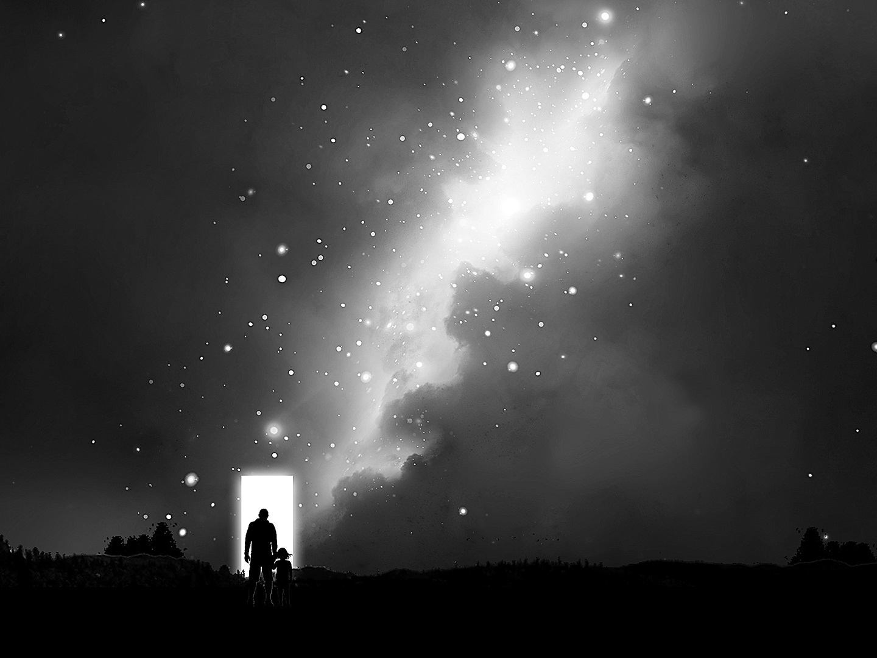
No one is independent
Romans 6:14 – You are under law or grace
Two realms Two dimensions
In Spirit Of the flesh
Heavenly realm Worldly realm
Under law Under grace
In death In life
In Christ In Adam

Slide 5
from law means free from sin 6:15, 16
I’m free from sin not free to sin
“Paul knows how difficult it is to bring men to understand a consistent preaching of grace; and especially to keep them from drawing false conclusions about it.” Anders Nygren

Slide 6
from sin means slaves to righteousness 6:17, 18
Slaves to sin
Ruled by law
“Guilty”

Slide 7
from sin means slaves to righteousness 6:17, 18
Slaves to sin
Ruled by law
“Guilty”
God’s gift
He transferred you – out from sin to righteousness

Slide 8
The Facts
“you believed that form of teaching” 6:17
‘pattern,’ ‘standard’ or ‘form’.

Slide 9
The Facts
“you believed that form of teaching” 6:17
‘pattern,’ ‘standard’ or ‘form’.
“To which you were entrusted”
Something God did to you.
‘handed over, placed there, turned over, transferred”

Slide 10
What then? Since I no longer abide under any kind of rule or regulation but under God’s favor, kindness and blessings, can’t I leave open the possibility of sin and indulge “Me” just a little? What a crazy notion!
It is so obviously clear that if I worshipfully listen and wholly submit to anyone as a slave then I am compelled to obey him. It matters not whether I am a slave to any sort of sin (with the result of death) or whether a slave of obedience (with the result of correct living.)

Slide 11
But thank God! I used to be a slave to the Selfish and Sinful Me but now…!... with every fiber of my being and with full attention and compliance I am molded by the teaching into which God placed me.
I have been emancipated from “The Sin of Me”
and have been placed in bondage to right living.

