Slide 1
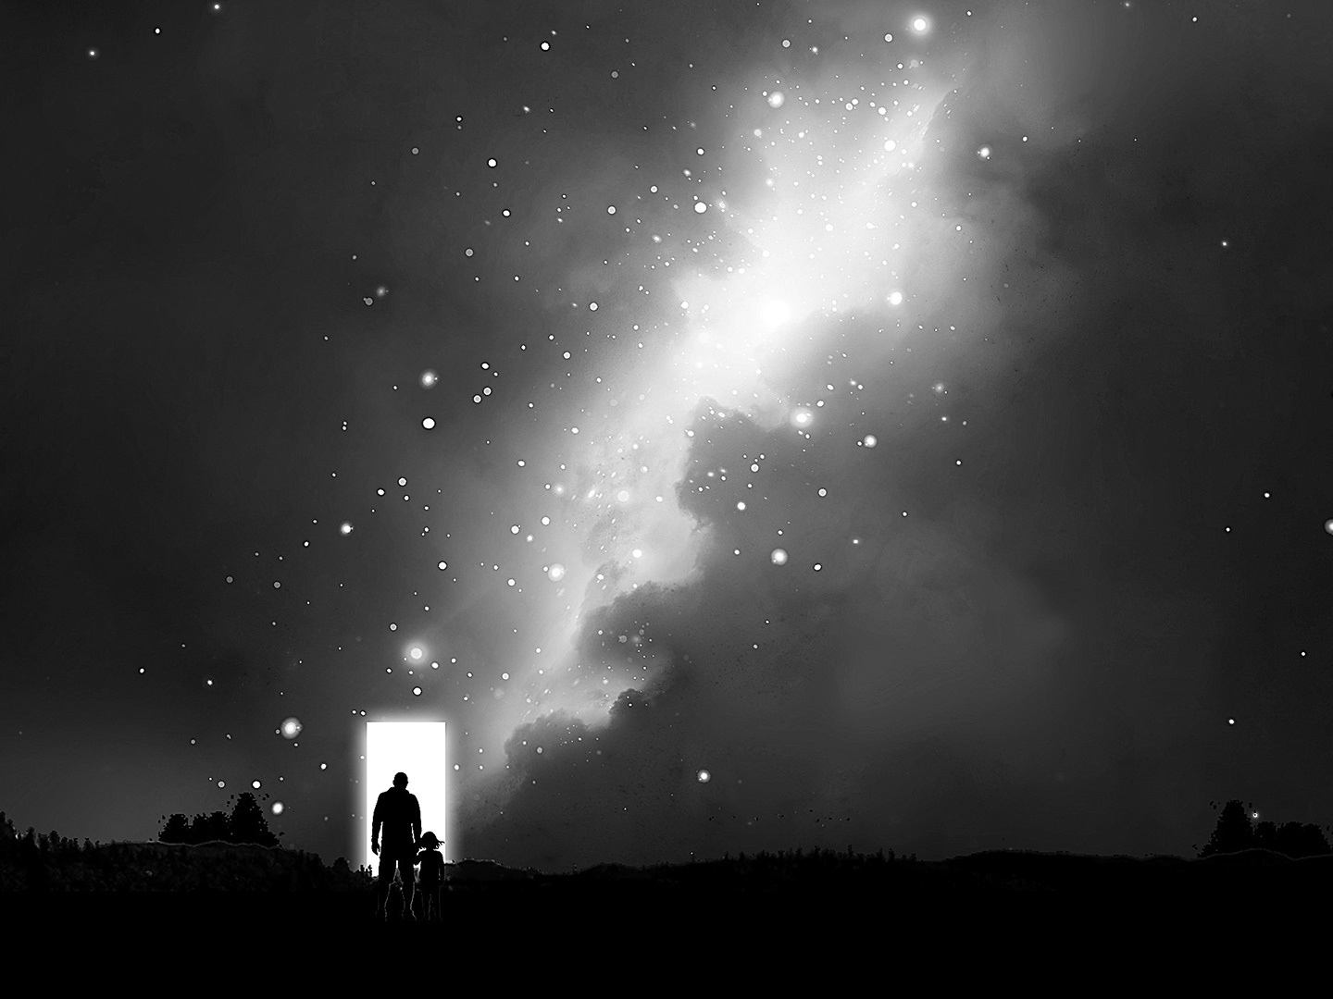
Living in a new dimension
Romans 6:14
You are not under law but under grace

Slide 3
A new dimension:
The dimension of Grace
For sin shall not be your master, because
you are not under law, but under grace
Romans 6:14

Slide 4
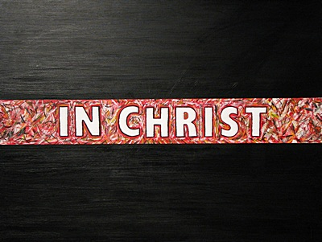
The place of reality:
the new dimension
In Sin
“Don’t you know that all of us who were baptized
into Christ Jesus were baptized into his death?”
6:3
…we died to sin; how can
we live in it any longer?”
6:2

Slide 5
Think differently
v. 11
Don’t enthrone
your passions
v. 12
Don’t manipulate others v.13
Under Grace
Use your personality to
do what is right
V. 13

Slide 6
Under Grace
For sin shall not be your master…
Romans 6:14

Slide 7
Christ is Lord
Sin is not your Lord
Under Grace
For sin shall not be your master…
Romans 6:14

Slide 8
Christ is Lord
Sin is not your Lord
Under Grace
“The Sin”
Defective “spiritual” gene passed down
For sin shall not be your master…
Romans 6:14

Slide 9
Under Law
Under Grace
~ Me-Centered
~ Rules control behavior
~ In Sin’s Dominion
~ Feelings Rule
~ Sin is Lord
~ God-Centered
~ Grace control behavior
~ In Christ’s Dominion
~ Relationship Rules
~ Jesus is Lord
…because your are not under law, but under grace
Romans 6:14

Slide 10
What shall I say to this? Should I live under
the same roof as Sin just so that there will be
a superabundance of Grace? Ridiculous!
I forever left the dominion of sin; how can I say
it’s still my home? It is quite clear that when I
was immersed into Christ Jesus I was plunged
into his death and bonded to every
benefit of his death.

Slide 11
Let me connect the dots for you:
Through a dipping under water,
I was buried with him into death.
This began a total separation from my old life.
Christ was raised, out from the dead,
by the magnificent majesty of the Father.
In exactly the same way, I am also
raised up like him, so that I might live
my new life in a uniquely new way.

Slide 12
In view of the fact that my baptism intertwined me
with him into a mirror image of his death,
I will certainly experience a similar likeness of his resurrection. Thus experiencing this: the “old me”
was crucified with him. The expressed purpose
of that crucifixion was so that the life of “Selfish Me”
might be completely defective thus I am no
longer slavishly devoted to “Sinful Me.”
For having experienced this death, God’s judgement pronounced me “just-as-if-I-had-never-sinned.”

Slide 13
On top of all of this, if I in fact died with Christ, I am firmly persuaded and am confident that I will also live with him.
For I have come to grasp that Christ, having been raised up from the dead will never face death again. He is outside of death’s jurisdiction and is no longer under its rule. The death Christ died was a one-time-death, but now, the life he currently lives, he lives oriented to God. So in the same way, I consider and think of “Selfish-Me” as truly a lifeless corpse in regard to “Sinful-me.” But indeed, now I live oriented with eyes toward God while implanted in Christ Jesus.

Slide 14
This is how it all comes together: I must not allow for any possibility for “Sinful-Me” to be King and pay attention
and comply to the urges, feelings and passionate
longings of my physical body. Neither will I keep on pampering any part of my personality using it as a
weapon or excuse toward hurtful living centered in
“Sinful Me”. Rather I will yield myself to God just as
if I was snatched out of death to Living! My whole
personality as a tool of right conduct oriented toward God

Slide 15
Because of this, it rules out as fact that sin
will ever dominate me. For I am in no way
under the rule of any kind of law.
I am subject to the power of God’s
kindness, love and blessing.

