Slide 1
To live you must die Romans 6:5-7
Part One

Slide 2
Main Point: Purposeful living involves knowing two facts and then acting upon that knowledge.
Golden moments of life
Live with purpose and “golden moments” are created.
Romans 6:5-11 gives us the structure of purposeful living.

Slide 3
Romans 6:5
Purposeful living is based in remembering who you are.
“In view of the fact that we have been united with him…”
How do you know that Jesus is the Son of God?
How do you know that
you are a
child of God?
Death, Burial, Resurrection
Our baptism is a physical event that helps us remember and know who we are.

Slide 4
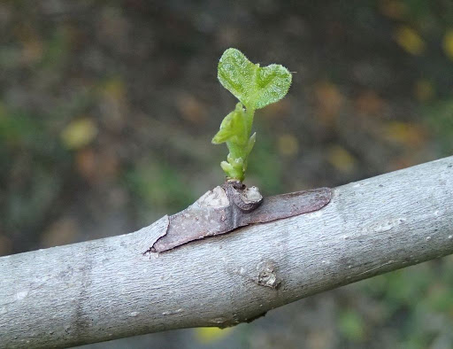
To live purposefully is to be
crucified with him 6:5a/6-7
You don’t have to do it,
you have already died!
For we know that our old self was crucified with him…6:6
“United”
‘grown together’ like a graft

Slide 5
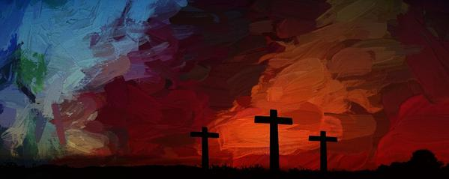
If I was crucified with him – my old self died, then why do I still struggle with sin?
Is a process
of change
“now” and “not yet”
You died to sin and to its dominion
The golden moments of your Christ-walk happen when you choose Life-decisions, when you choose to follow your new Lord and not the ways of sin.

Slide 6
What shall I say to this? Should I live under
the same roof as Sin just so that there will be
a superabundance of Grace? Ridiculous!
I forever left the dominion of sin; how can I say
it’s still my home? It is quite clear that when I
was immersed into Christ Jesus I was plunged
into his death and bonded to every
benefit of his death.

Slide 7
Let me connect the dots for you:
Through a dipping under water,
I was buried with him into death.
This began a total separation from my old life.
Christ was raised, out from the dead,
by the magnificent majesty of the Father.
In exactly the same way, I am also
raised up like him, so that I might live
my new life in a uniquely new way.

Slide 8
In view of the fact that my baptism intertwined me
with him into a mirror image of his death,
I will certainly experience a similar likeness of his resurrection. Thus experiencing this: the “old me”
was crucified with him. The expressed purpose
of that crucifixion was so that the life of “Selfish Me”
might be completely defective thus I am no
longer slavishly devoted to “Sinful Me.”
For having experienced this death, God’s judgement pronounced me “just-as-if-I-had-never-sinned.”

