Slide 1
Examine Your Faith
Part 4
Examine yourselves to see whether you are in the faith; test yourselves.
2 Corinthians 13:5

Slide 2
Principle of Inquiry
Where do we find our answers?
All a man’s ways seem right to him,
but the Lord weighs the heart
Proverbs 21:2

Slide 3
Examples of Inquiring of God
Seeking God
Judges 1:1,2
Seeking Self
Judges 21:25
Judges 20:18,23,27 – when life is threatened
Genesis 25:22– physical issue
1 Kings 22 – when afraid of the answer
Joshua 9:14 – when they did not inquire

Slide 4
Inquiring of God Today
To seek, ponder, study, investigate, ask, seek with application, follow, practice.
Kingdom Inquiring: Matthew 7:7,8
Asking in Faith
James 1:5,6

Slide 5
Listen to me, you who pursue righteousness and who seek the Lord. Look to the rock
from which you were cut and to the
quarry from which you were hewn
Isaiah 51:1,2
… for they drank from the spiritual rock
that accompanied them, and
that rock was Christ
1 Corinthians 10:4

Slide 6
Since, then, you have been raised with Christ, set your hearts (seek) on things above, where Christ is seated at the right hand of God. Set your minds (think) on things above, not on earthly things.
Colossians 3:1,2

Slide 7
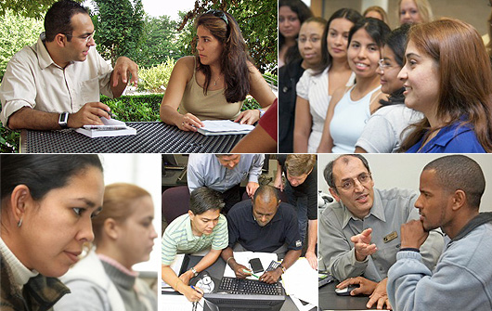
“Little Prayers”
“For you died, and your life is now hidden with Christ in God” Col. 3:3

