Slide 1
Examine Your Faith

Slide 2
Examine yourselves to see whether you are in the faith; test yourselves.
Do you not realize that Christ Jesus
is in you – unless, of course, you fail
the test. And I trust that you
will discover that we have not
failed the test.
2 Corinthians 13:5,6

Slide 3
Everyone has some type of faith
Definitions of faith
A strong belief in a supernatural power
or powers that control human destiny
Acceptance of ideals, beliefs, etc., which are not necessarily demonstrable through experimentation or reason
Belief that does not rest on logical proof
or material evidence.

Slide 4
Types of Faith
Dead faith ~ James 2:17
Little faith
Faith possessed by demons ~ James 2:19
Legalistic Faith ~ Matthew 23:23
Mixed Up Faith ~ 2 Timothy 3:5

Slide 5
Biblical Faith
The faith – what is to be believed
Faith – acting on the what
The Faith is God’s revelation to man – a record of historical reality.

Slide 6
We have a responsibility to The Faith
Guard It –
Guard what has been entrusted to your care…and in so doing have wandered
from the faith – 1 Timothy 6:20,21
Preach It –
Preach the world… – 2 Timothy 4:2
Contend for It –
Struggle with skill and commitment – Jude 3

Slide 7
Our response to “the faith” is “our faith”
Hebrews 11:1
Now faith is being sure of what we hope for and certain of what we do not see.
Action accompanies faith
“Offered, built, went, blessed, spoke, hid, chose, passed through the Sea”

Slide 8
The Faith
…the message they heard was of no value to them, because those who heard it did not combine it with faith – Heb. 4:1 2
Faith
Numbers 13
Matthew 6
“Don’t worry! The battle is won. Go take the land.
“Don’t worry about physical things. Seek first the kingdom.

Slide 9
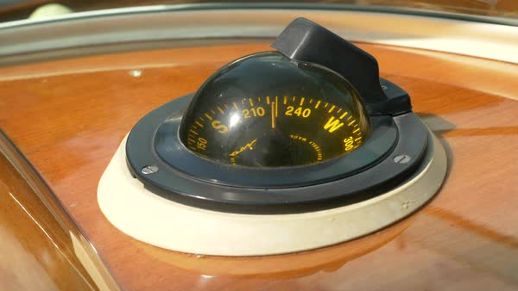
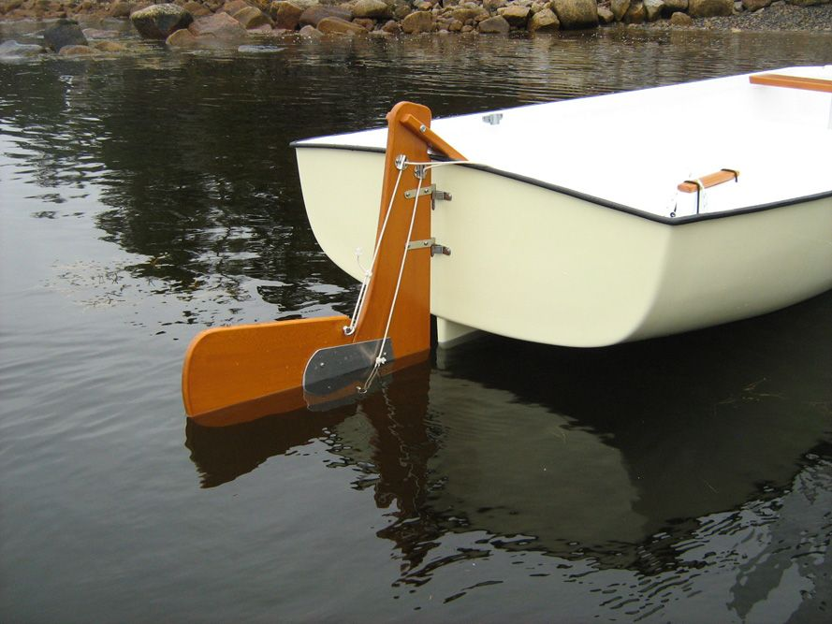
Faith does not rely on feelings

Slide 10
We must always uphold “the faith,” study it, know it. But it is not “faith” until we apply it to our lives.

