Slide 1
Hospitality: Going Beyond Being Friendly
Hebrews 13:2
UPWARD
Outward
WARD
IN

Slide 2
Do not forget to entertain strangers,
for by so doing some people have
entertained angels without knowing it.
Hebrews 13:2

Slide 3
Hospitality Begins in the Household of God
Offer hospitality to one another without grumbling.
1 Peter 4:9
“must be hospitable.”
1 Tim 3:2; Titus 1:8

Slide 4
Hospitality Extends Beyond the Household of God
Therefore, as you have opportunity,
let us do good to all people, especially to
those who belong to the family of believers
Galatians 6:10
Hospitality is a characteristic of one’s life,
not isolated moments of life.

Slide 5
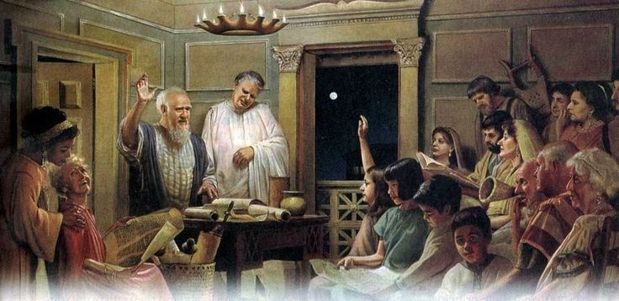
Hospitality Begins in the Home
Church met in Philemon’s house
Philemon 1:2
Church met in Aquila & Priscilla’s house
I Cor. 16:19
“ate together with glad and sincere hearts” Acts 2:26

Slide 6
Hospitality Extends Beyond the Home
The character of hospitality
Hospitality means listening
Hospitality means caring
Hospitality is shown in helping others
Hospitality does not expect reward

Slide 7
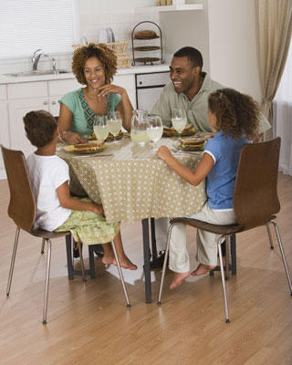
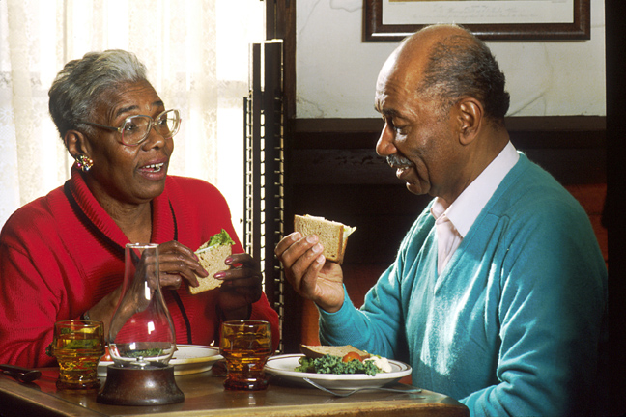
Hospitality
More of a lifestyle
than an event
Is given cheerfully
Helps others feel comfortable
Is Generous
Is centered in Who you love

