Slide 1
Equal Concern
for one another
1 Corinthians 12
UPWARD
WARD
IN

Slide 2
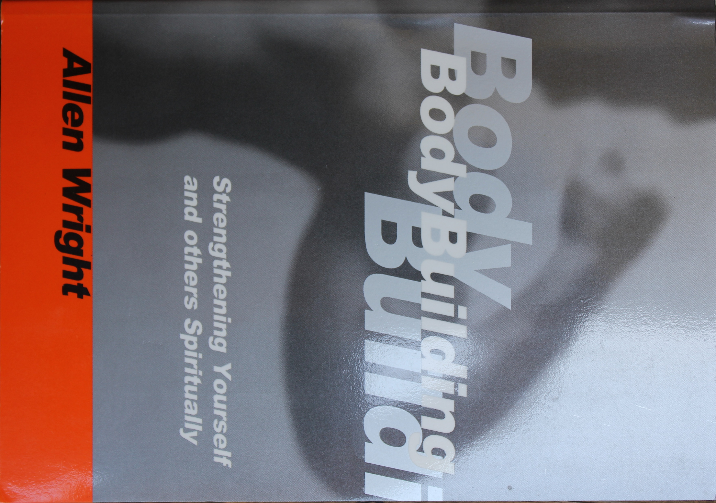
The Church
~ A Family
~ A Bride
~ A Building
~ Sheep
~ A Body

Slide 3
The Body is one
God Arranged the parts just as He wanted them to be
1 Cor. 12:12-13,18
The body is a unit, though it is made up of many parts; and though
all its parts are many, they form
one body. So it is with Christ.
For we were all baptized by one Spirit into one body…
For all of you who were baptized into Christ have clothed yourselves with Christ. ~ Gal. 3:27

Slide 4
God Arranged the parts just as He wanted them to be
1 Cor. 12:12-13,18
Their previous background is of
no consequence
God put you where he
wants you!
…whether Jews of Greeks, slave or free – and were were all give the one Spirit to drink..
But in fact God arranged the parts in the body, every one of them, just as he wanted them to be…1 Cor. 12:18

Slide 5
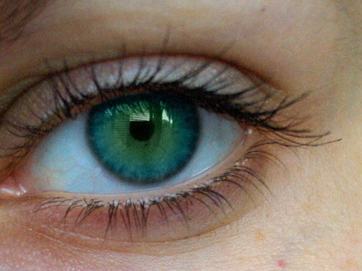
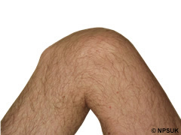
The Dissatisfied Part (after Dr. Seuss)
1 Corinthians 12:15 “If the foot should say
‘Because I am not a hand. . .”
An eye is what I’d like to be
I no longer want to be a knee
A knee which bends and turns and stresses
Can only cause a lot of messes.
But an eye is in such an elevated place
Has a tight socket, a comfortable space
Has vision and insight and lots of beauty
To which everyone exclaims, “What a cutie!”

Slide 6
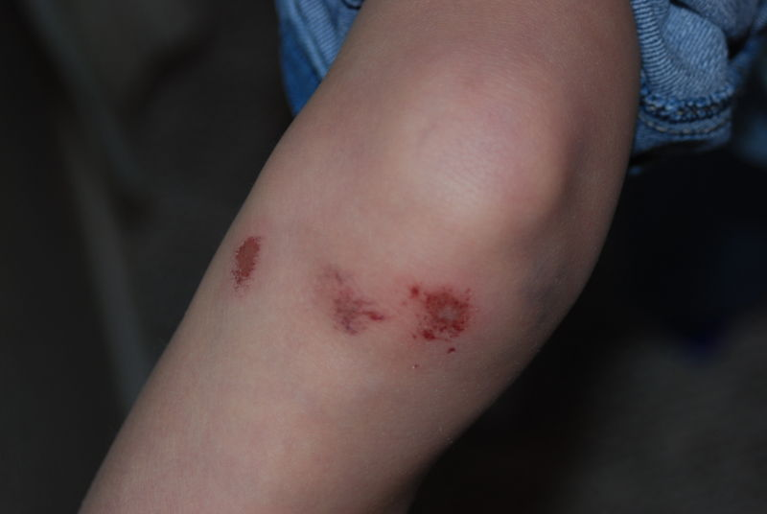
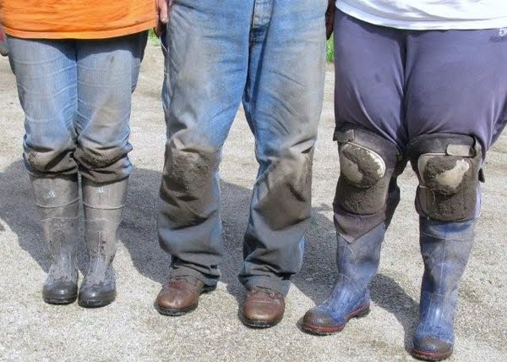
The Dissatisfied Part
But being a knee can be so depressing
(excuse me for my honest confessing)
For no one notices me who works so hard
Who pulls and pushes and gets all scarred.
I get no help, I get no credit
All I get is “hey you! Don’t sweat it!
“Quit complaining and do your job
“And by the way, don’t be such a slob
“You scrape the ground and get all dirty
And in short dresses you try to be flirty
But you’re ugly and round, stay in your place!
You’re nothing but an awful disgrace.”

Slide 7
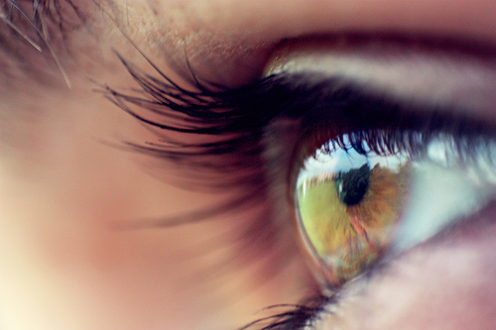
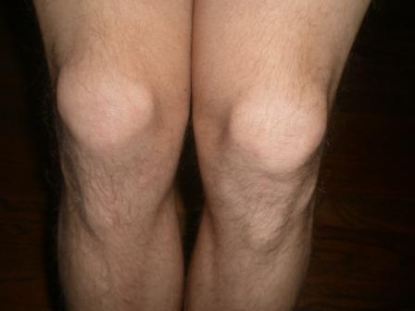
The Dissatisfied Part
An eye is what I’d like to be
I no longer want to be a knee
I want to be a nicer feller
I want others to think I’m “sweller”.

Slide 8
The Body has many parts
One body, mutually interdependent
1 Cor. 12:19-24a, 26
If they were all one part, where would the body be? As it is, they are many parts, but one body. The eye cannot say to the hand, “I don’t need you!” And the head cannot say to the feet, “I don’t need you!” On the contrary, those parts
of the body that seem to be weaker are indispensable, and the parts that we think are less honorable we treat with special honor. And the parts that are unpresentable are treated with special modesty, while our presentable parts need no special treatment.
If one part suffers , every part suffers with it; if one part is honored, every part rejoices with it.

Slide 9
The Body has many parts
One body, mutually interdependent
1 Cor. 12:19-24, 26
A dissatisfied part of the body
is still a part of the body
What part of Christ’s body am I?

Slide 10
II
I Need Thee Not
1 Corinthians 12:21 “The eye cannot say to the hand
‘I don’t need you’”
“I need thee not, o lowly foot”
Said the hand to that lower fellow.
My gifts are many, there’s lots to do
I’m much more effective without you

Slide 11
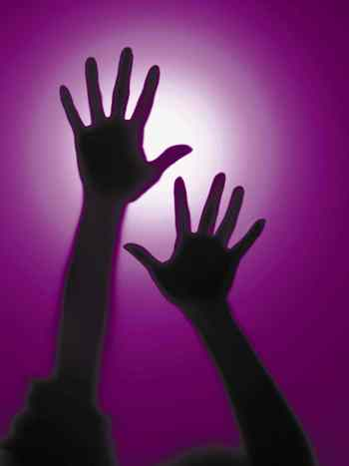
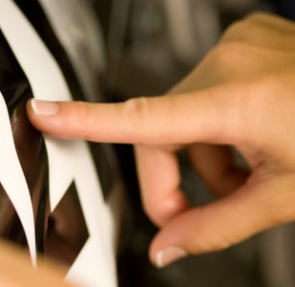
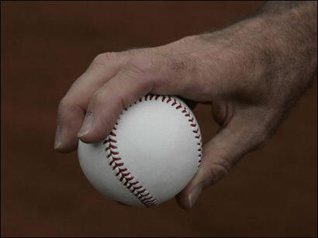
For as you can see I can reach and touch
And grab and stroke and feel and clutch.
I protect and lift and cover a sneeze,
And point and throw and hold and tease;
And help and count on all my fingers,
And type and write and direct the singers.
While you, o foot do none of these
I need thee not, so leave, please.”

Slide 12
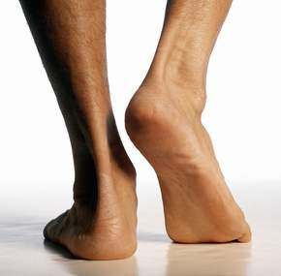
“You are right, o hand, you reach much higher than me
You can do all those things that I cannot, I see.
So I will take my leave
As you have told me to
And go some other place
Then see how you do.

Slide 13
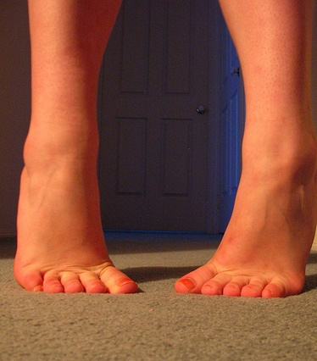
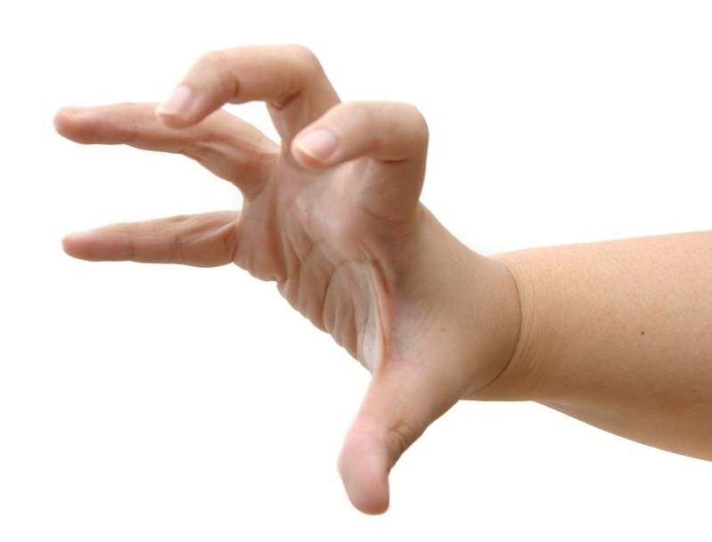
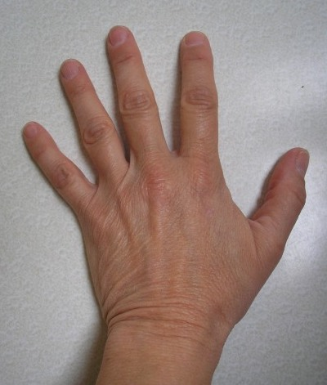
For your reach will not reach has high without me
Your touch will not go far you soon will see
Your clutch will not clutch
So very much
And when you reach out for something to clasp
You’ll find that your reach exceeds your grasp
For without a lowly foot to take you places
You’ll be restricted to limited spaces.

Slide 14
Show Equal Concern
1 Cor. 12:24,25
Why? ~God-centered
But God has combined the members of the body and has given greater honor to the parts that lacked it, so that there should be no division in the body, but that its parts should have equal concern for each other.
God Assigned them 12:11
God Arranged them 12:18
God Combined them 12:24
God Appointed them 12:28

Slide 15
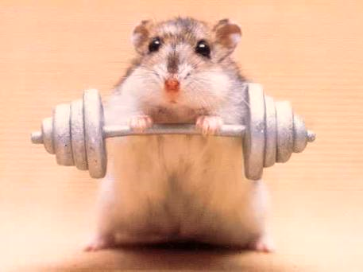
Keep your eyes on Jesus:
Let us fix our eyes on Jesus, the author and perfecter of our faith…
(Hebrews 12:2)
Serve one another in love:
Do not use your freedom to indlulge the sinful nature; rather, serve one another in love.
(Gal. 5:13)
The key for a healthy, happy body:

Slide 16
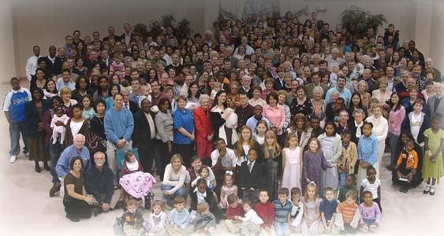
III
The Head Speaks to the body
1 Cor. 12:27 “Now you are the body of Christ,
and each one of you is a part of it”
1 Cor. 13 – “…but have not love…I am nothing.”
Oh body of mine
Can’t you see
How you need Me
And others?
For your hand
Needs your foot
And your foot needs
Your hand.
One cannot do well
Without the other.
And here’s a mystery
To think your whole life through:
I need you
For you are my mouth
To speak to others
You are my feet
To go and help

Slide 17
III
The Head Speaks to the body
You are my hands
To lift and heal
You are my arms
To hug the weary
You are my knees to kneel and pray
You are my heart to feel a hurt.
You are my shoulders
To bear the load
Of someone else

Slide 18
III
The Head Speaks to the body
How can the world be won
without love?
How can you be one
without love?
How can you know my love
without showing your love?
How can you truly, abundantly live
without the sharing of love?
For when you love
Then you will know
And the world will know
That you are mine
And that all we are . . . together. . . is love

