Slide 1
From Words To Flight: Becoming God’s Special Possession
A Community of Ministering Priests

Slide 2
The Love of God… (1 John 5:3)
God’s intent has always been for a people who live according to God’s will.
God’s commands are not burdensome! They give us “wings.”
Tended to be people of The Book, rather than “God’s special possession.”
Problem of Israel (Isaiah 48:17 ff) and the Pharisees…
Consider Peter’s descriptions of the identity of followers of Jesus:
Chosen people
Royal priesthood
Holy Nation
God’s Special Possession
People of God
Requires us to live as foreigners and exiles, living good lives that represent God’s character and purposes to the world…

Slide 3
Incredible Responsibility, Immense Joy!
Just finished speaking tour (Italy) focused on the credibility of the Bible
International Bible Festival (Vicenza, Italy) this year’s theme “polis”
2 Corinthians 3:1-3 “You are our letter – written with the Spirit of the living God.” We are called to be the credibility of Scripture by our behavior…
Philippians 3:17-21 – Enemies of the cross; our citizenship…
Serious call to new identity. We are to be the embodiment of truth (remember Ephesians 4:15-16) truthing life in love, we show the world the Christ the world needs.
A priest is not one who does spiritual things, but is an ambassador, one who prepares another for an encounter with God.
Message of Peter – “Be holy.”

Slide 4
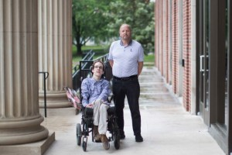
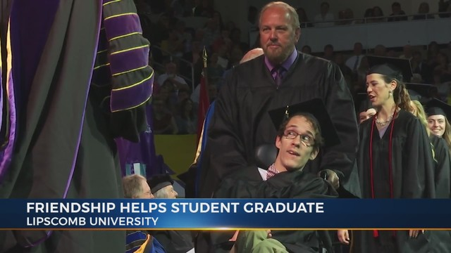
Life-giving Example: Priesthood Embodied…
Seth Walker, Ken Brassel

Slide 5
Be the Jesus the World Around You Needs…
Peter’s message of being holy includes embracing Jesus as our hypogrammos in all aspects of life, particularly suffering
Do not repay evil with evil or insult, but with blessing
In your hearts, revere Christ as Lord
Be ready to answer – because of your hope…
Answer with gentleness and respect.
Christ Jesus suffered so that we might be made whole…
If we are going to “take flight” – we must follow in the steps of Jesus – the true high priest who shows us how to be priests – living sacrifices for the sake of the world to the glory of God!

