Slide 1
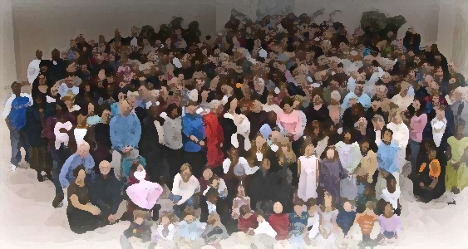
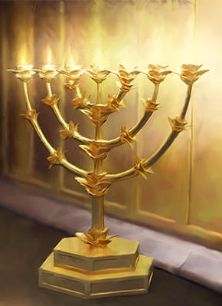
The Lampstand
at Central
The Focus on Jesus
Revelation 1:4-7

Slide 2
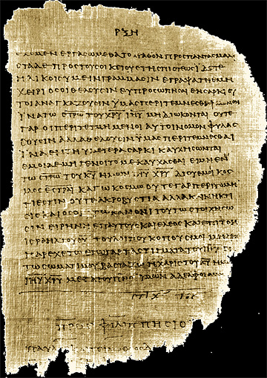
1st Century Letters
From whom, to whom
Greetings
Prayer

Slide 3
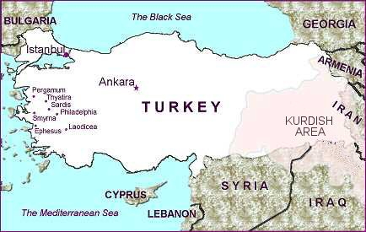
From whom, to whom
(Person and Place)
Apostle John
7 Churches of Asia

Slide 4
Greetings
Grace (Greek)
God’s good gifts that we don’t deserve
Peace (Hebrew)
Wholeness or completeness.

Slide 5
“From him who is, and who was, and who is to come.”
Prayer
The I AM handled Pharaoh and he will handle Caesar.
“From the seven spirits
before the throne”
Completion and perfection
Zechariah 4:6,10
Isaiah 11:2

Slide 6
“From Jesus Christ”
Prayer
He is the faithful witness
who loves us.
He is the Firstborn from the dead who freed us by his blood
He is the ruler of the kings of the earth and has made us to be a kingdom of priests

Slide 7
DOXOLOGY
…to him be glory and power for ever and ever! Amen.
Look, he is coming with the clouds,
and every eye will see him,
even those who pierced him,
and all the peoples of the earth will mourn
because of him.
So shall it be! Amen!

Slide 8
Applications
Be strategic in our work
Be comforted in the help of God
God is in control

