Slide 1
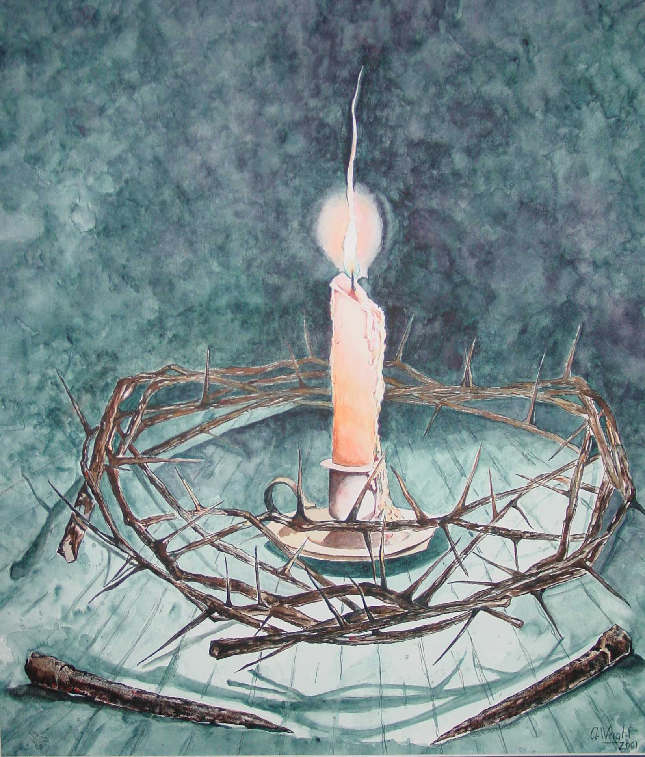
Love Doesn’t Always Feel
Nice

Slide 2
“Love is the feeling you feel when you feel you are feeling a feeling you feel you’ve never felt before!”
“The first time I fell in love, it was unlike anything I had ever experienced…I didn’t know what it was really like until I experienced it. Having such strong feelings about another person shook me to my core. I made me re-evaluate my beliefs. I learned what it was like to really care about someone. Everything I had believed, everything
I stood for, suddenly disappeared.”

Slide 3
Christian Love is not
Devoid of Feeling
Be devoted to one another
in brotherly love.
Romans 12:10
Love between relatives you like.
“Now that you have purified yourselves by obeying the truth so that you have sincere love for you brothers, love one another deeply, from the heart.
1 Pet. 1:22

Slide 4
Love sometimes hurts
2 Thess. 3:6-12
Principle of discipline
Matthew 5:38-42
Principle of honoring the offender.
2 Cor. 5:2-5; 2 John 1:7-10
The principle of rejection.

Slide 5
Love is doing what is right
Love
The goal is not to hurt
and the goal is not to be nice.

Slide 6
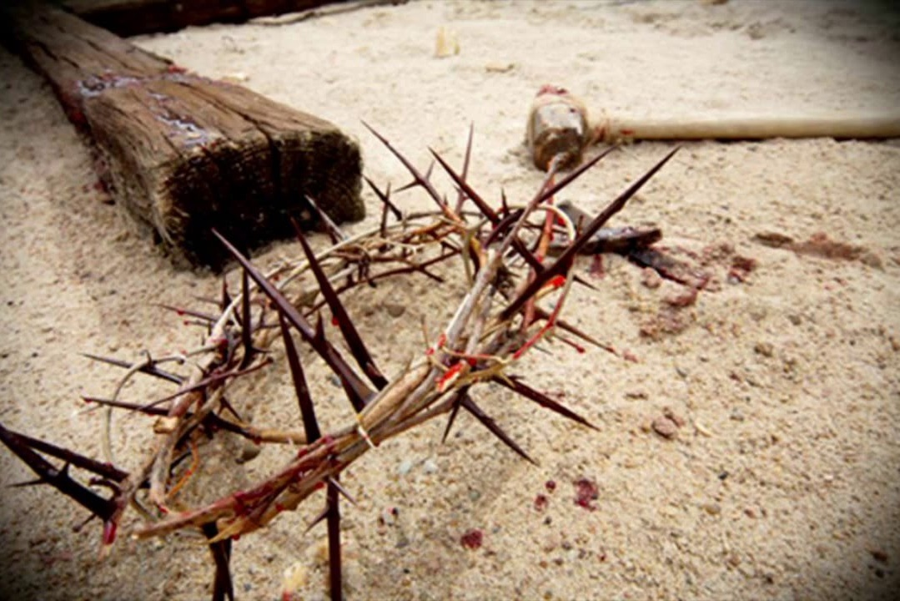
Love hurts,
love scars,
love wounds
and mars
This is how we know what love is:
Jesus Christ laid down his life for us.
1 John 3:16

