Slide 1
The Joy of Faithfulness
Be faithful until death, and I will give you the crown of life. Revelation 2:10

Slide 2
The joy you give others
We proclaim to you what we have seen and heard so that you may also have fellowship with us.
And our fellowship is with the Father
and with his Son, Jesus Christ.
We write this to make our joy complete.
1 John 1:3,4

Slide 3
The joy you give others
It has given me great joy to find some of your children walking in the truth, just as the Father commanded us.
2 John 1:4
My true son in the faith…
1 Tim. 1:1

Slide 4
The joy you give others
It is right for me to feel this way about all of you, since I have you in my heart.
Philippians 1:7
Tychicus will tell you all the news about me. He is a dear brother, a faithful minister and fellow servant in the Lord
Colossians 4:7

Slide 5
The joy you give others
At my first defense, no one came to my support, but everyone deserted me
2 Tim. 4:16

Slide 6
The joy you give yourself
Faithful is not so much doing things
as maturing in Christ.
But he said, “My grace is sufficient for you, for my power is made perfect in weakness.” Therefore I will boast all the more gladly about my weaknesses, so that Christ’s power may rest on me
2 Cor. 12:8,9

Slide 7
The joy you give yourself
Though you have not seen him, you love him, and even thought you do not see him now, you believe in him and are filled with an inexpressible and glorious joy, for you are receiving the goal of your faith, the salvation of your souls.
1 Peter 1:8,9

Slide 8
The joy God gives you
The joy of the Lord is our strength
Nehemiah 8:10
I have told you this so that my joy may be in you and that your joy may be complete.
John 15:11
I am the vine; you are the branches
John 15:5

Slide 9
The joy God gives you
To him who is able to keep you from falling and to present you before his glorious presence without fault
and with great joy
Jude 1:24
The one who calls you is faithful
and he will do it
1 Thess. 5:24

Slide 10
EUREKA!
It has given me (I have found) great
joy to find some of your children
walking in the truth…
2 John 1:4

Slide 11
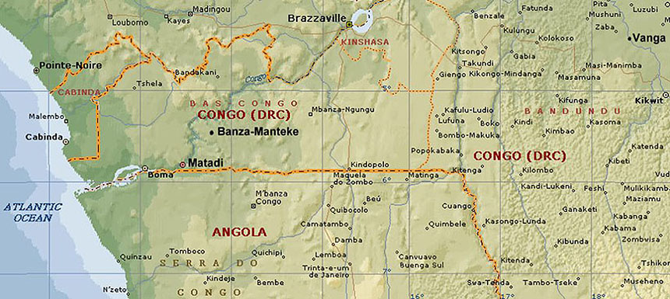
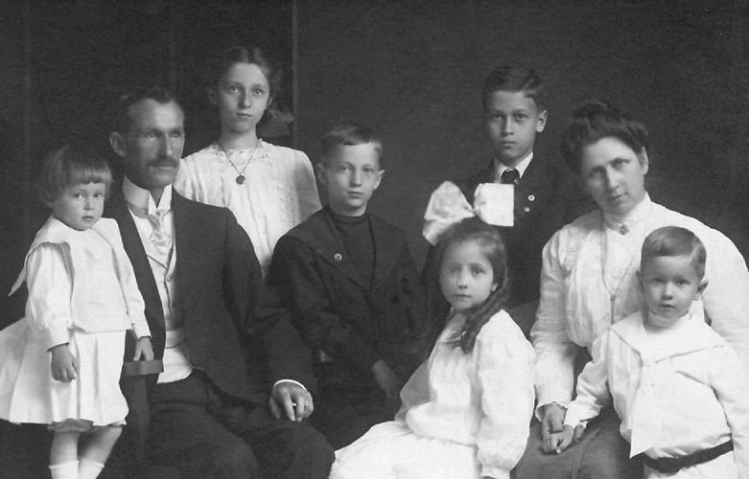
Dr. William Leslie

Slide 12
"These will wage war against the Lamb, and the Lamb will overcome them, because He is Lord of lords and King of kings, and those who are with Him are
the called and chosen and faithful.“
Revelation 17:14

