Slide 1
For we know, brothers, loved by God,
that he has chosen you
1 Thessalonians 1:4

Slide 2
It is essential to live out the truth
instead of a lie.
If anyone thinks he is something when he is nothing, he deceives himself.
Gal. 6:3

Slide 3
The Reality of an Aimless World
Your enemy the devil prowls around like a roaring lion looking for someone to devour
1 Pet 5:8
The thief comes only to steal
and kill and destroy.
John 10:10

Slide 4
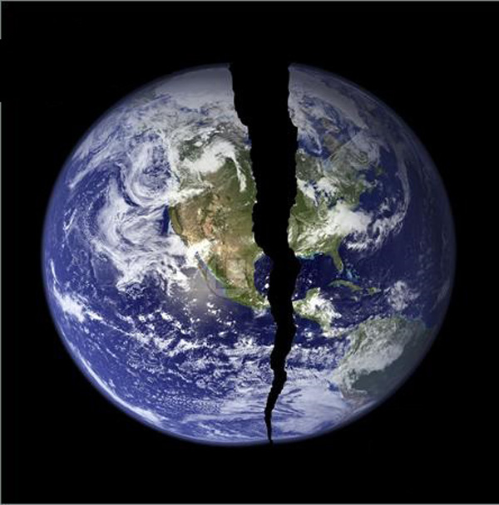
The world tries to fix things in the wrong way.
LOST
I came to seek and save the lost.
Lk 19:10
I came that they may have life and
have life to the full
Jh. 10:10
Called you out of darkness into
his marvelous light
1 Pet 2:9

Slide 5
1st reality:
Jesus reveals is that the world is lost and needs saving.

Slide 6
The Reality of
If I be lifted up I will draw all men to me
Jh 12:32
He called us by his own glory and goodness
2 Pet. 1:3
Called according to his purpose…
those he called he justified.
Rom 8:28,30

Slide 7
1st Reality:
Jesus reveals is that the world is lost and needs saving.
2nd reality:
God calls us out of the world into a relationship with him.

Slide 8
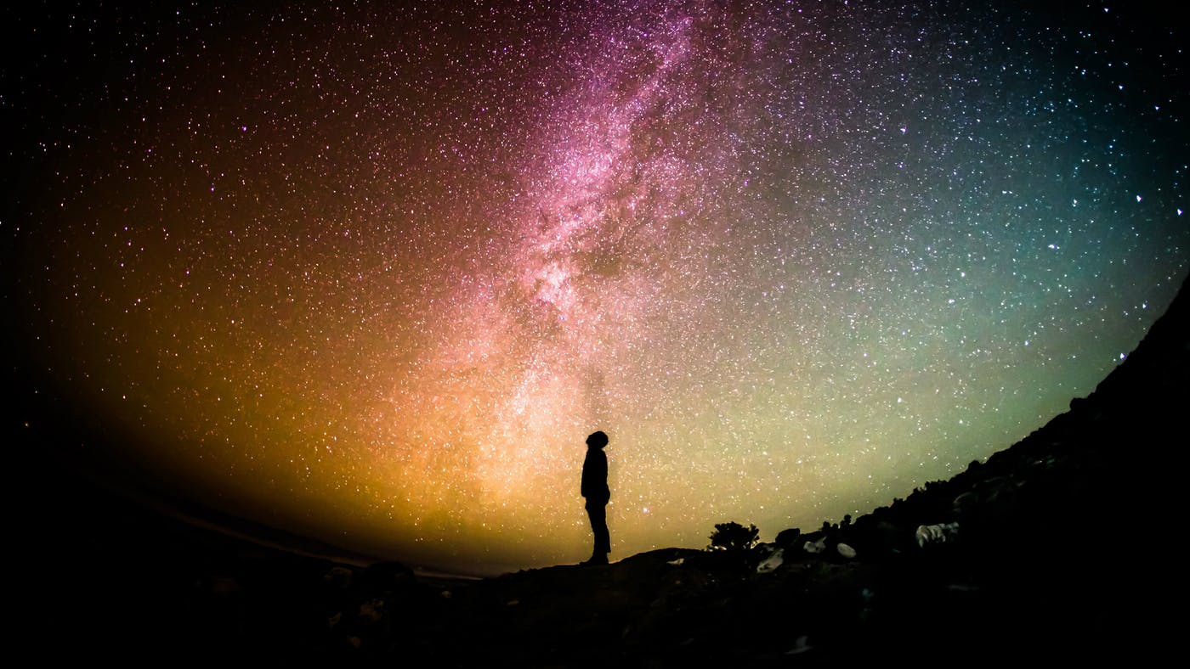
All that the Father gives me will
come to me (God’s work) and whoever comes to me (people’s free will)
I will never drive away.
John 6:37
The reality of the Chosen
If you are in Christ, you are chosen.
If you hear the message of Christ you have
the opportunity to be chosen.

Slide 9
To the chosen lady
2 John 1
To God’s elect
1 Pet. 1:1
(Jesus) chosen by God and precious to him…you are a chosen people, a royal priesthood, a holy nation, a people belonging to God
1 Pet. 2:4,9
The Joy of being chosen
Valued
Special
Held in esteem
Worthy of a task

Slide 10
1st Reality:
Jesus reveals is that the world is lost and needs saving.
2nd reality:
God calls us out of the world into a relationship with him.
3rd Reality:
in Christ you are special, valuable, esteemed and dearly loved by God.

Slide 11
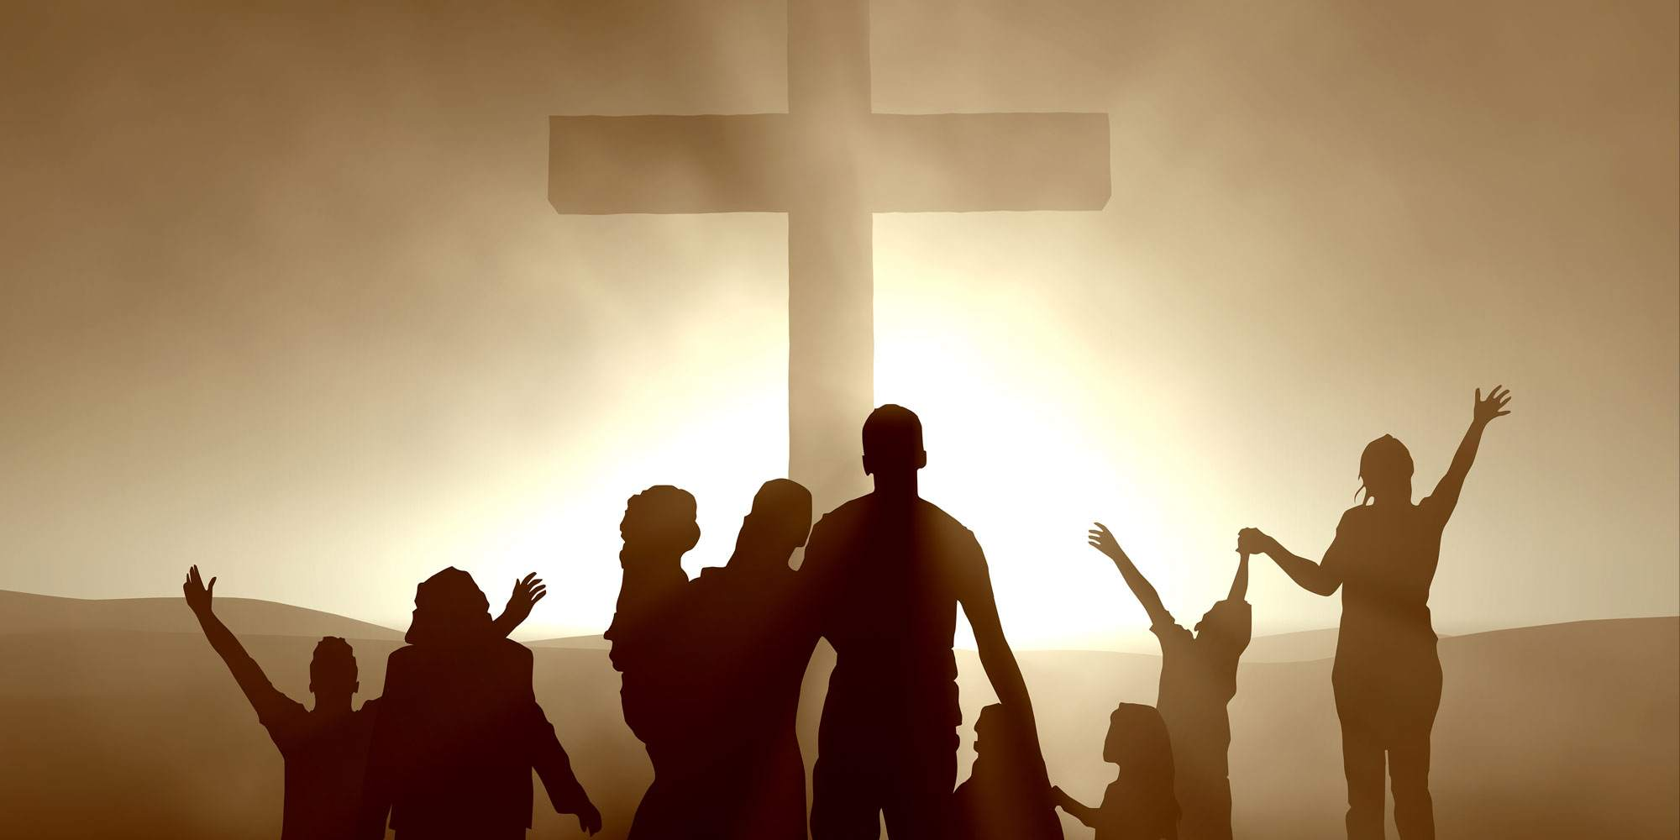
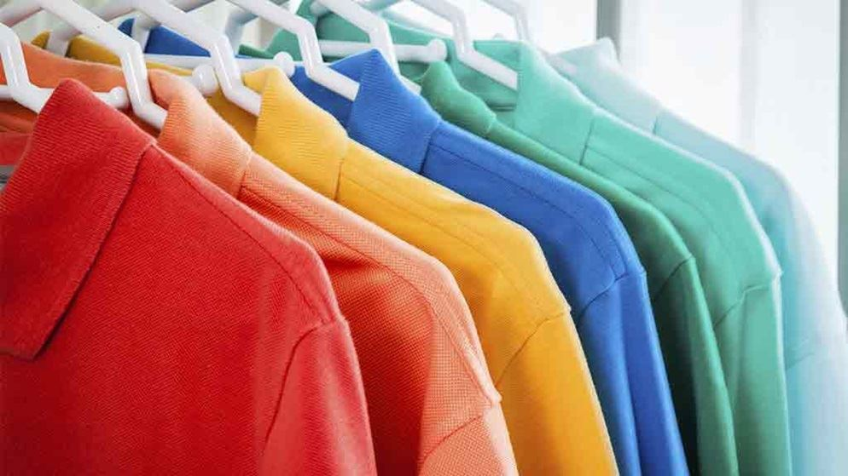
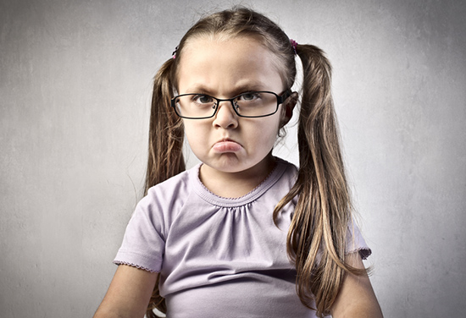
Choice Ones wear choice clothes
We were not chosen to become spoiled brats
The Reality of the Lives of the Chosen

Slide 12
God chooses us to choose right clothes
As God’s chosen people, holy and dearly loved, clothe yourselves with
compassion, kindness, humility, gentleness and patience
Col. 3:12
Choice ones choose obedience
1 Peter 1:1,2

Slide 13
1st Reality:
Jesus reveals is that the world is lost and needs saving.
2nd reality:
God calls us out of the world into a relationship with him.
3rd Reality:
in Christ you are special, valuable, esteemed and dearly loved by God.
4th reality:
I choose how
to live out my chosen life.

Slide 14
“Special
Forces”
Specially picked
Best
Valued
Out! I Say!

Slide 15
“When God looked into the future, far
before he spoke creation into existence, he said,
“Out, I say!”
And in that moment of reality he placed us into the reality of living in Christ, seeing us and treating us as holy and blameless chosen ones.

Slide 16
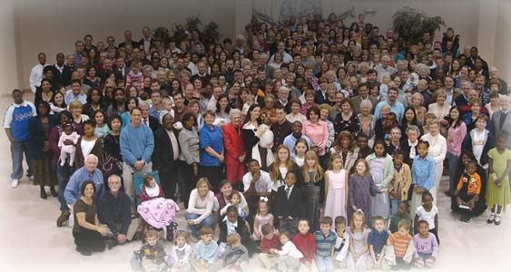
There was a man named Rufus…
There was a woman named…
There was a man named…
“Cream of the Crop”

